Slide 1
The Agent Is a Loop
Author: Konrad Kowalczyk
Repository: ai-agents-JAVA-SPRING

Slide 2
Let's start from the beginning
RAG
This is a continuation of last year's presentation, which focused on…
TOOLS
CHAT MEMORY “REDIS”
OLD REPO
xkondix AI Sandbox

Slide 3
Roadmap
1. The Agent Is a Loop
Writing one by hand, and what frameworks hide when they write it for you
2. Agentic Workflow Patterns
Five shapes, two frameworks, and when the DSL earns its keep
3. MCP as a Process Boundary
Tools, resources and prompts over two transports: HTTP for agents, STDIO for Claude Desktop
4. How Do You Know It Works?
Traces, metrics, logs and dashboards for everything your agents actually do

Slide 4

The Agent Is a Loop
What is an agent?
Build it -> No framework
Hide it -> LangChain4j
Control it -> Spring AI
Mix it -> One provider, ∞ protocols

Slide 5
What is an agent?
SUCCESS
AGENT
=
+
LOOP
STOP CONDITION
FAILURE / LIMIT REACHED

Slide 6
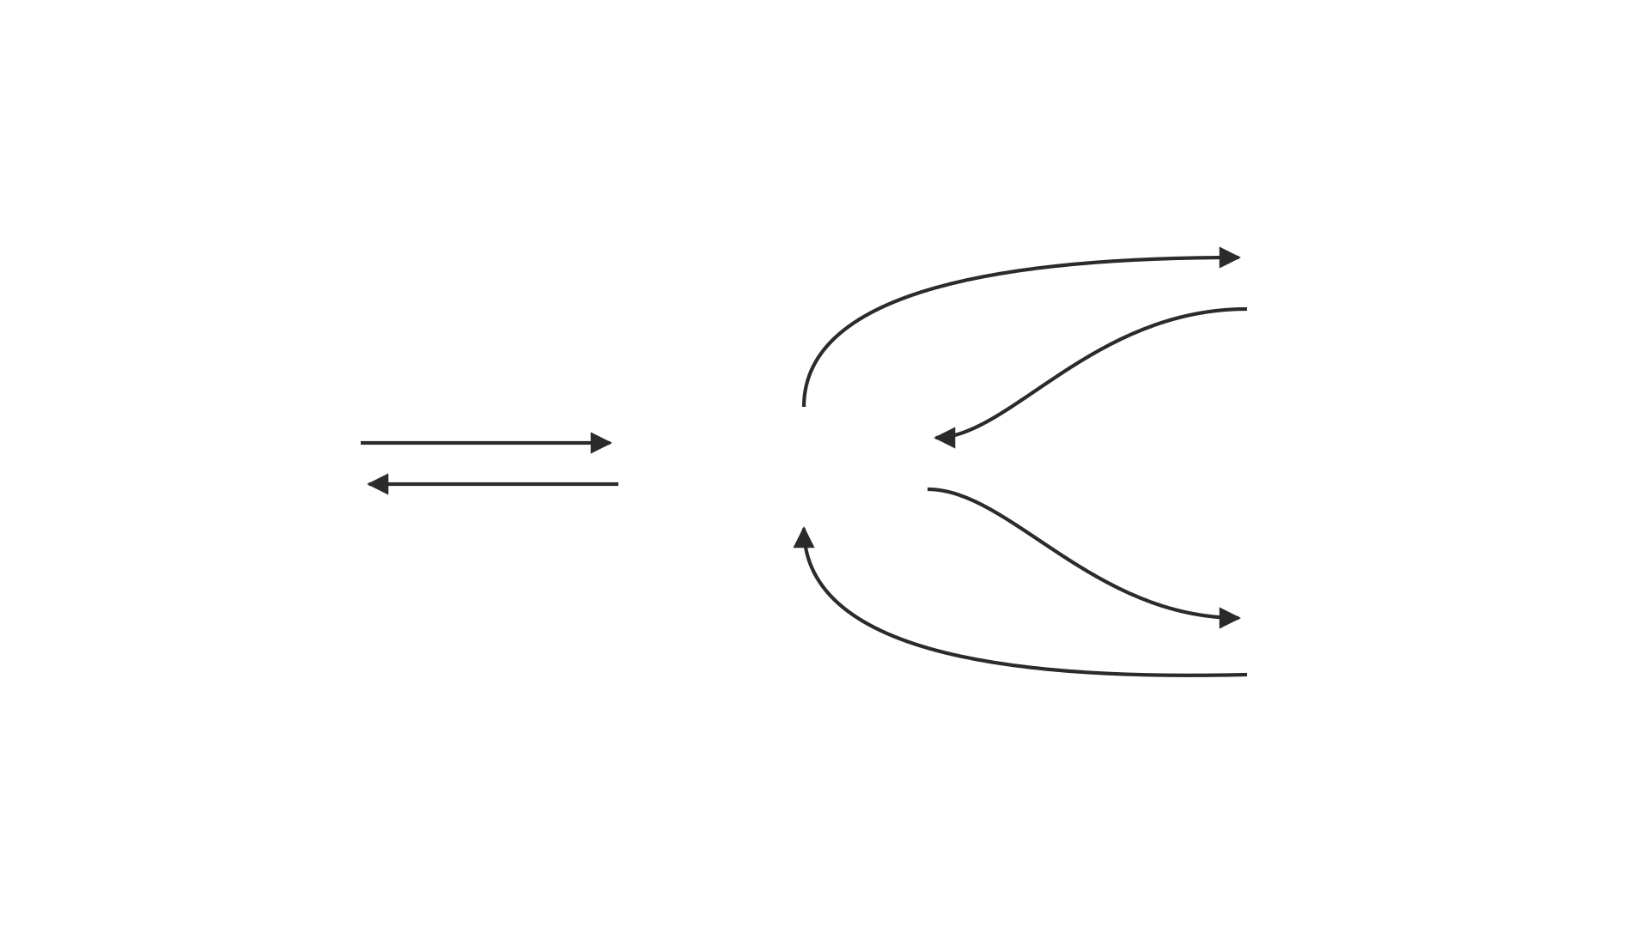

Slide 7
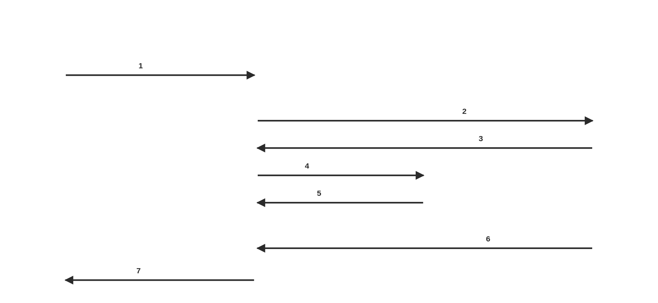

Slide 8
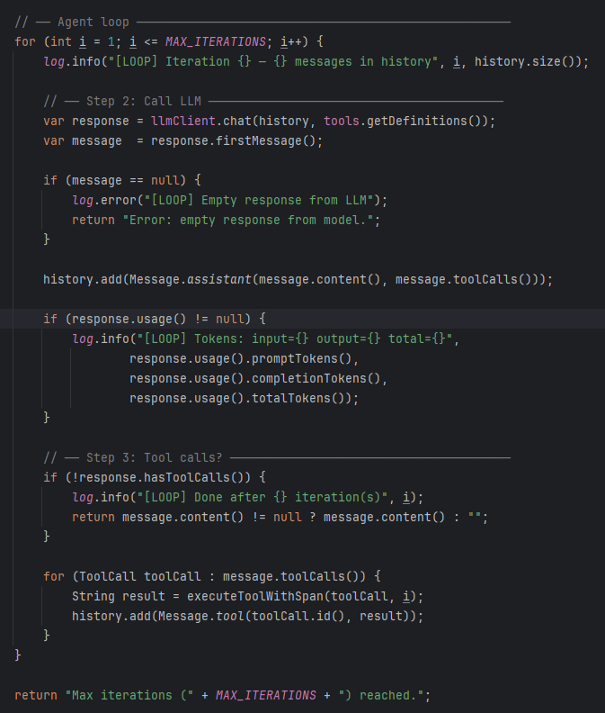
Raw Agent
The loop exits when the model stops requesting tools.
stop condition = no more tool calls
openai
sources
strandsagents

Slide 9
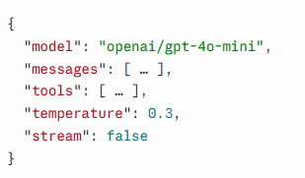
The request body structure
Every exchange with the model is JSON. The framework only decides who writes it.
MODEL → the model that handles this request
MESSAGES → the whole conversation, resent on every call
TOOLS → your Java methods, exposed to the model
TEMPERATURE →
STREAM →
lower: more deterministic
higher: more random
false: one complete response
true: chunks as they are generated

Slide 10
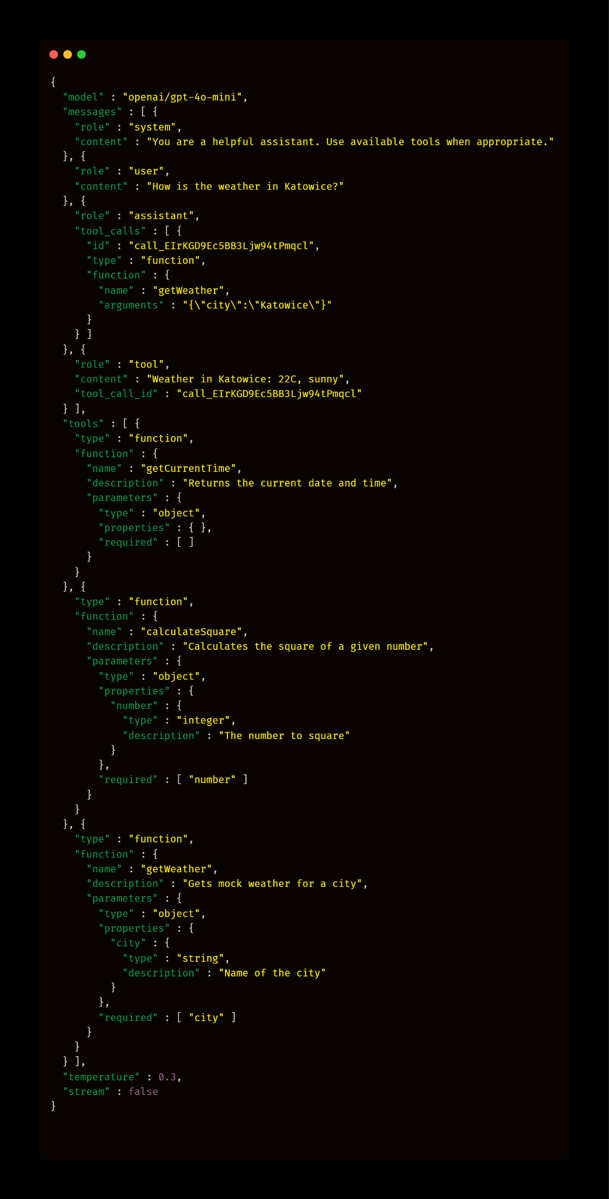
The request body as JSON
MESSAGES []
SYSTEM → the instructions
USER → the question
ASSISTANT → a request for a tool
TOOL → the result your code produced
ASSISTANT → the answer
┐
LOOP
┘

Slide 11
The request body as JSON
MESSAGES []
SYSTEM → written by dev, before the conversation
USER → written by the user
ASSISTANT → written by the model ┐
TOOL → written by your app ┘
ASSISTANT → written by the model
LOOP

Slide 12
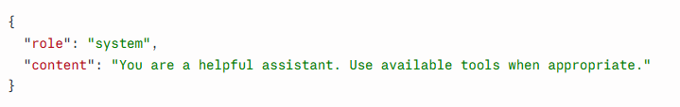
SYSTEM ROLE
The system prompt is the job description.
Written once by a human, resent on every iteration.

Slide 13
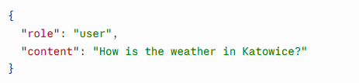
USER ROLE
The question.
Written by the user, resent on every iteration.

Slide 14
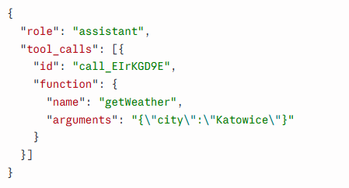
ASSISTANT ROLE
The model either asks for a tool, or gives the final answer.
A tool request means the loop continues.

Slide 15
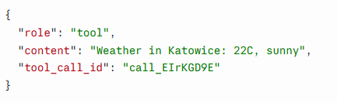
TOOL ROLE
The result. Written by your app, never by the model.
tool_call_id matches the request, because the model may ask for several at once.

Slide 16
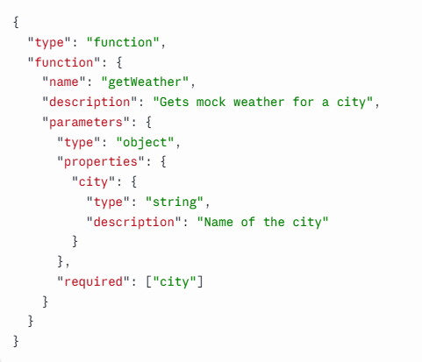
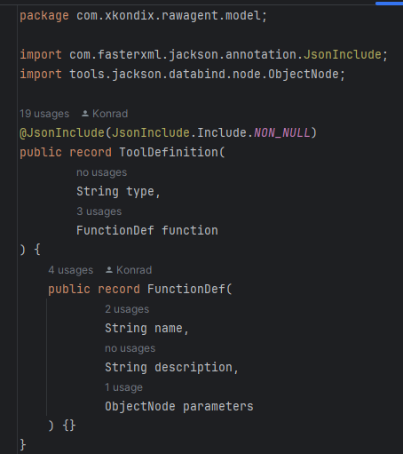
TOOLS
The functions the model may ask you to call.
Name, description and JSON schema that's all it knows about your code.

Slide 17
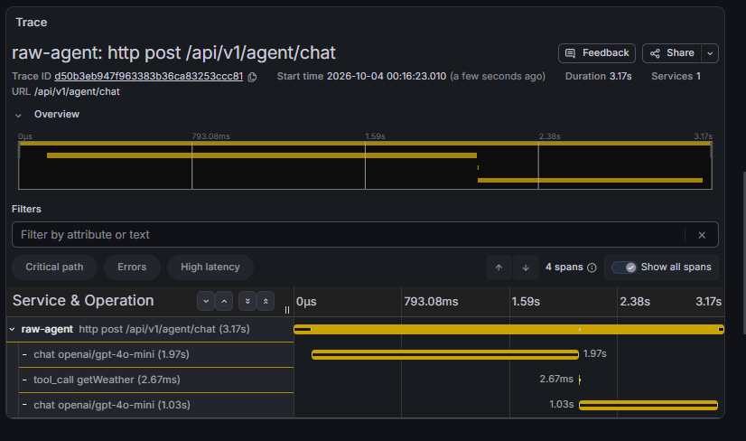
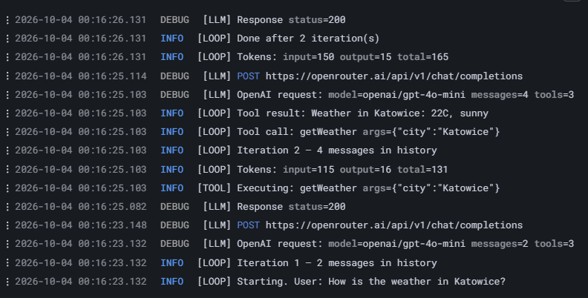
Observability

Slide 18

LangChain4j Agent
Everything AiServices does, LangChain4j also lets you do yourself.
Same library, same tools, same model. Only the level of abstraction moves.

Slide 19
LangChain4j Abstraction
ChatModel → you run the loop
AiServices → the framework runs it
AgenticServices → you declare the workflow [part Ⅱ]

Slide 20
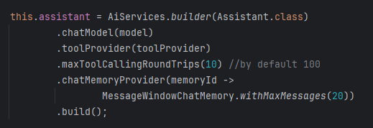
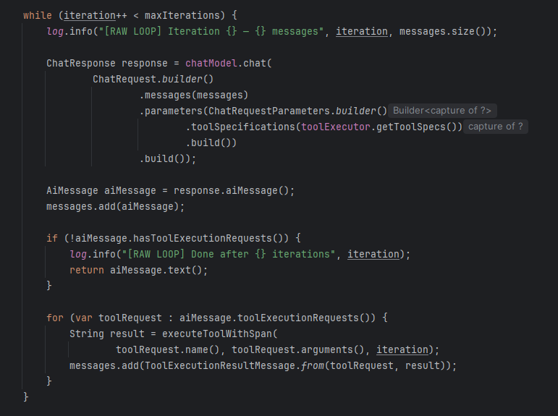
LangChain4j Loop
with AiServices
without AiServices
.toolProvider(toolProvider)is a custom provider, wrapped for observability
.tools(demoTools)is simpler, but invisible in traces

Slide 21
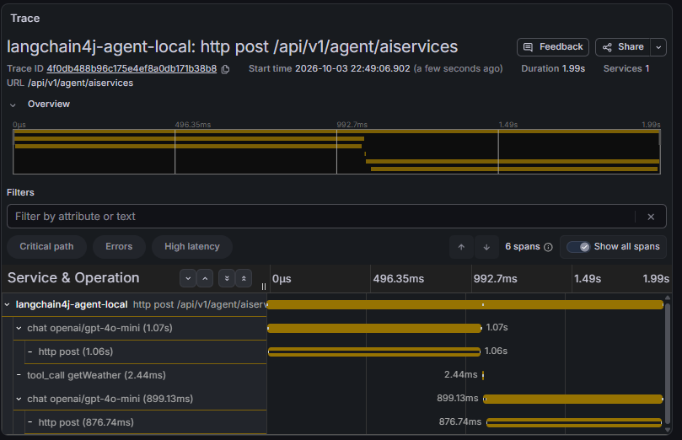
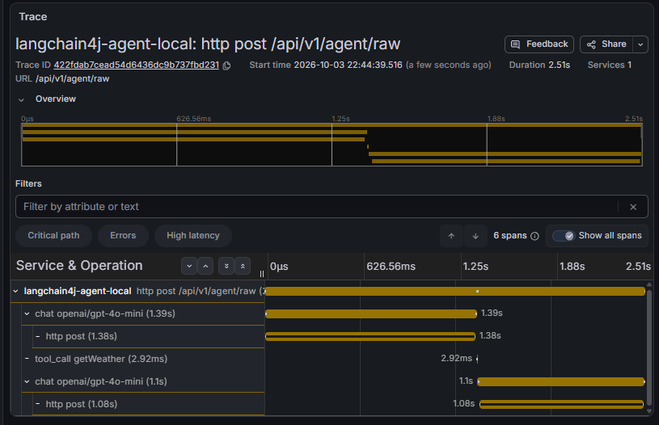
Traces
with AiServices
without AiServices

Slide 22
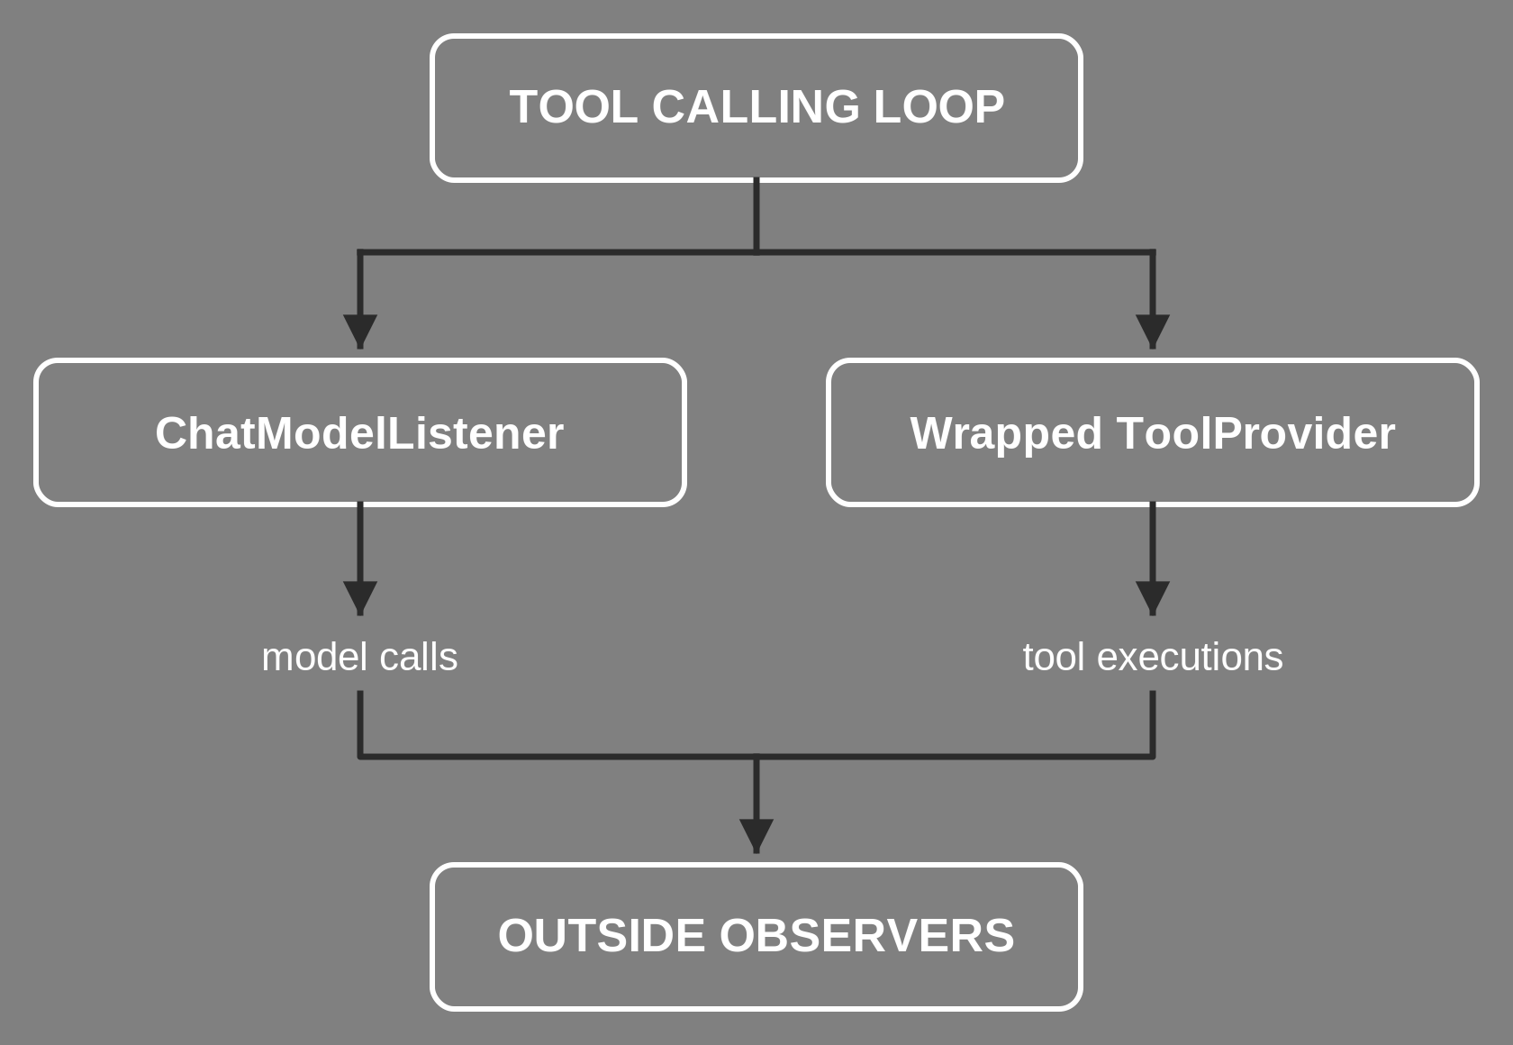

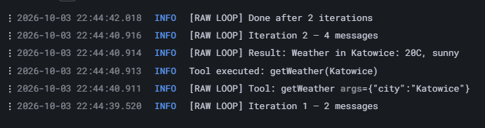
Logs
The loop is still observable, just from the outside.
A ChatModelListener sees every model call and tool request.
A wrapped ToolProvider sees every tool execution.
with AiServices
without AiServices

Slide 23
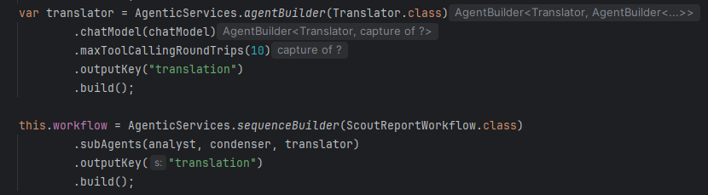
AgenticServices
More in chapter Ⅱ

Slide 24

Spring AI
Spring AI doesn't hide the loop, it puts it in a chain you can reach
Same chain, same client, same model. Only one advisor is the loop.

Slide 25
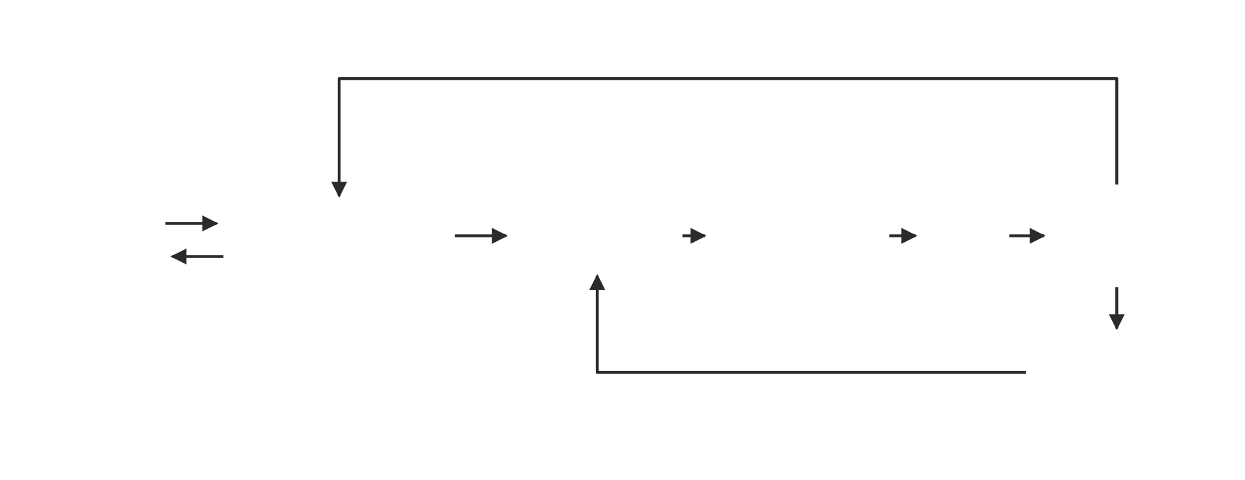
What is an Advisor?
An Advisor is middleware between your application and the AI model. It works similarly to an aspect, allowing you to add behavior around AI interactions.
It can modify requests, process responses, and control the flow of interactions with the model, keeping this logic separate from your application code.

Slide 26
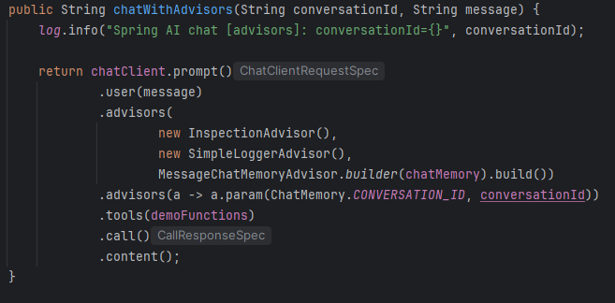
Advisor Code Snippet
Adding advisors to the chain
Parameter configuration for advisors (linking an identifier with a message)

Slide 27
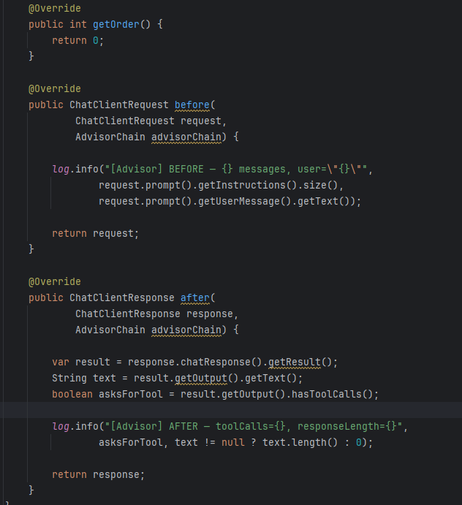
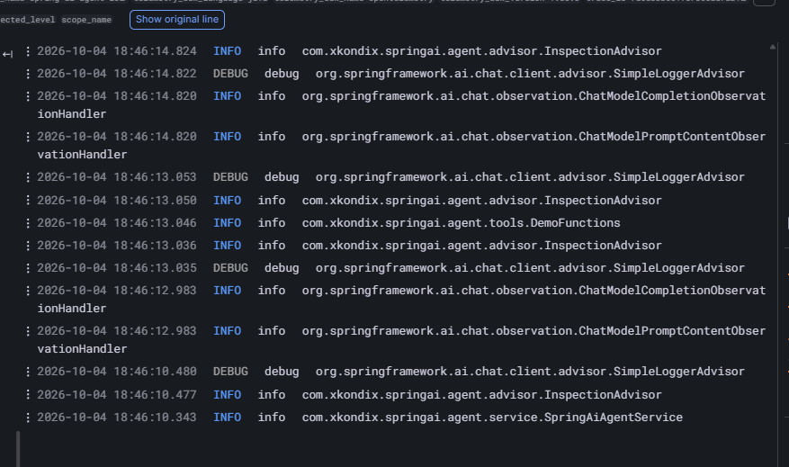
Before and After
1
2
2
1

Slide 28
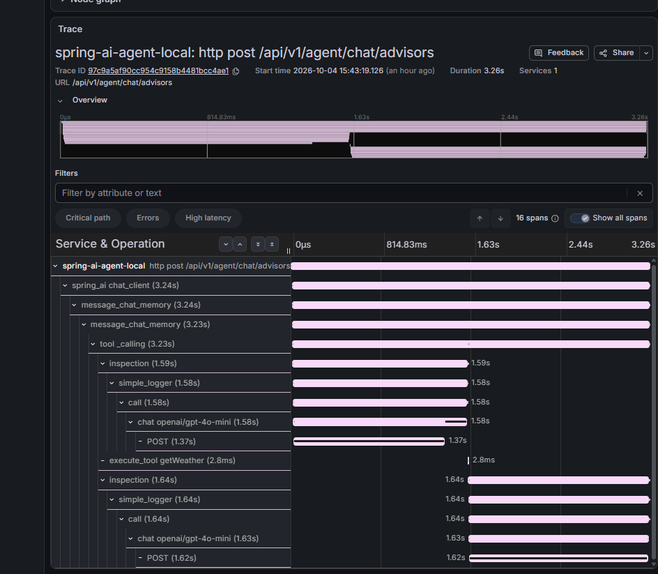
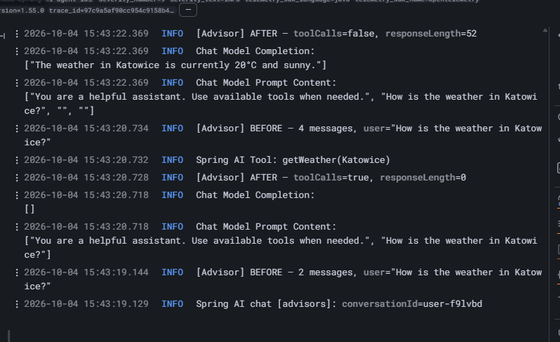
Advisors Inside the Loop
LOOP

Slide 29
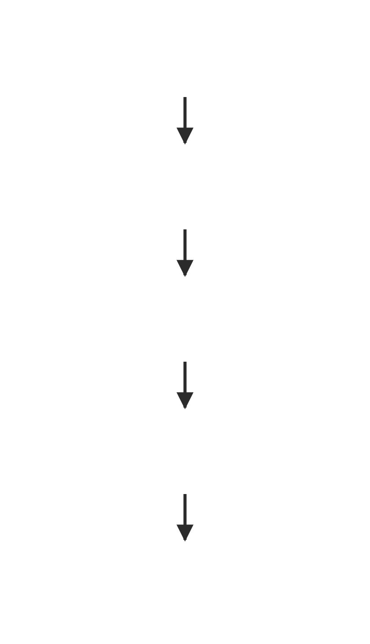
Advisor Order
The execution order of advisors in the chain is determined by the getOrder() method.
Lower order = earlier in the chain, farther from the model [LLM].
Higher order = later in the chain, closer to the model [LLM].

Slide 30
Example of Advisors
Order ID Value
MessageChatMemoryAdvisor → adds history as separate messages
QuestionAnswerAdvisor → adds context from a vector store (RAG)
SafeGuardAdvisor → checks the prompt and history for banned words
ToolCallingAdvisor → owns the tool calling lifecycle
SimpleLoggerAdvisor → logs request and response information
MIN_VALUE + 200
0
0
MIN_VALUE + 300
0
Integer.MIN_VALUE = -2 147 483 648 ← HIGHEST_PRECEDENCE (doc name)
Order 0 is not first. It is inside the loop!!!

Slide 31
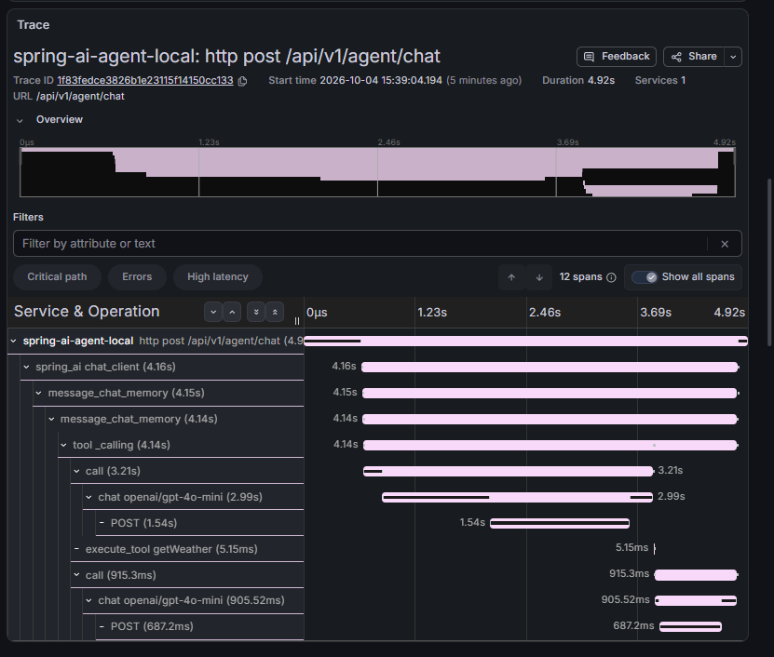
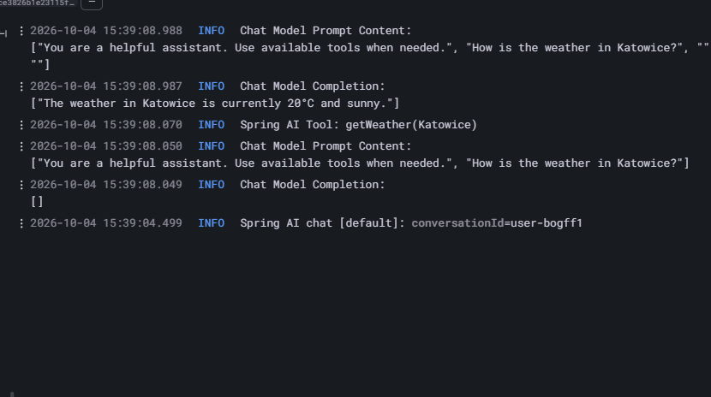
Default

Slide 32
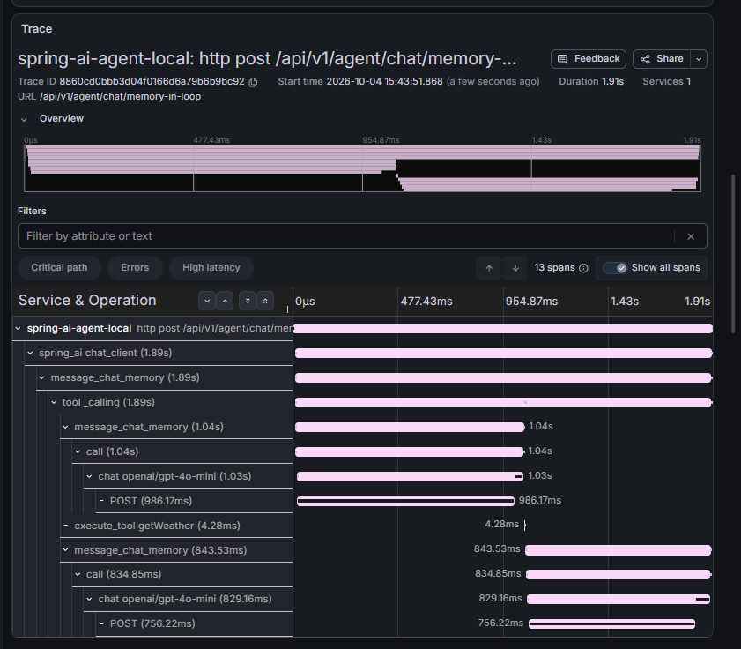
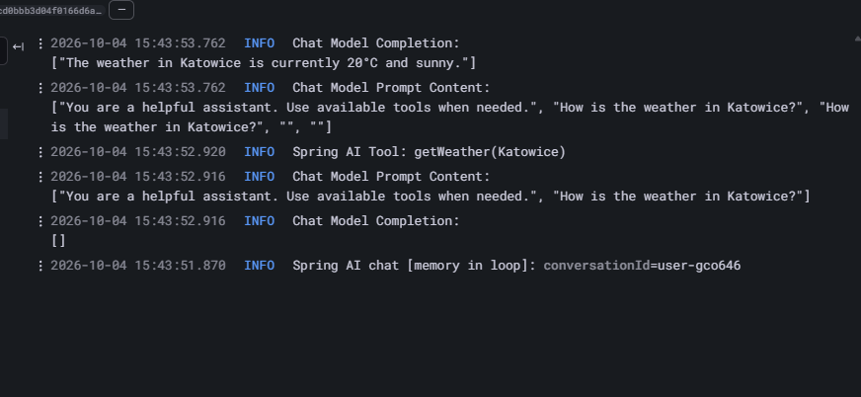
Memory in the Loop
Now one of them is inside the loop.
The docs advise against two memory advisors. This is why the question is sent twice.

Slide 33
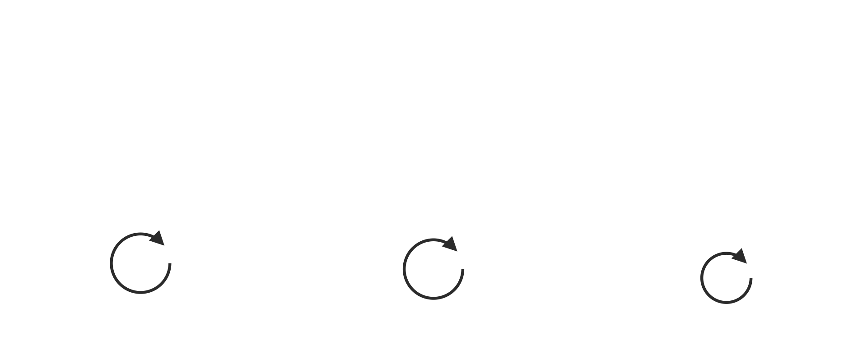
Three levels of hiding the loop

Slide 34
Who stops the loop?
Implementation | Limit | When exceeded
raw-agent | 10 iterations | a string in HTTP 200, indistinguishable from an answer
LC4j AiServices | 100 by default (10 in the demo) | exception
Spring AI 2.0.1 | 40 per tool / 150 per request doc | response with a dedicated finish reason

Slide 35
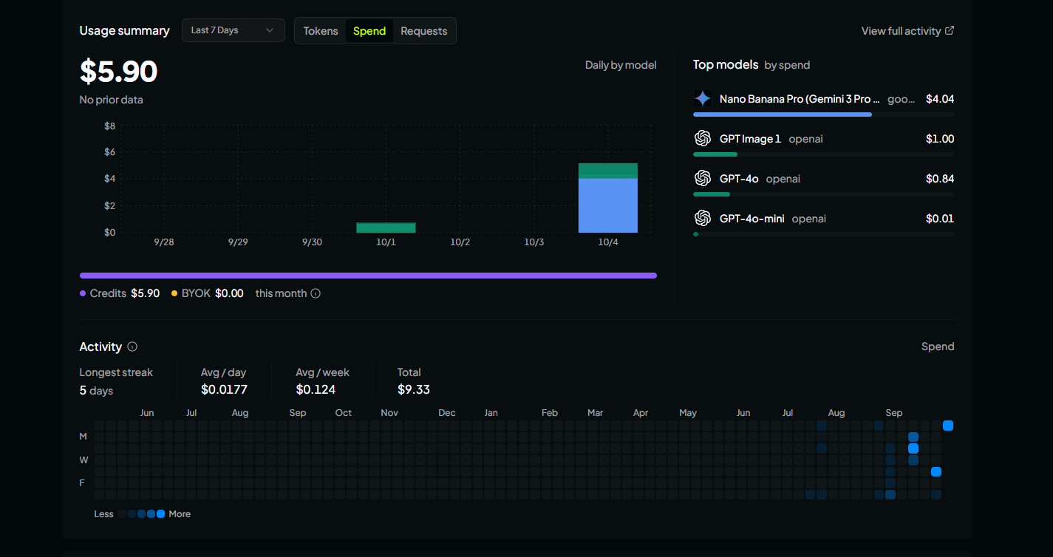
OpenRouter
OpenRouter is a single API in front of hundreds of models from dozens of vendors.
One key, one base URL, and the OpenAI protocol everyone already speaks.

Slide 36
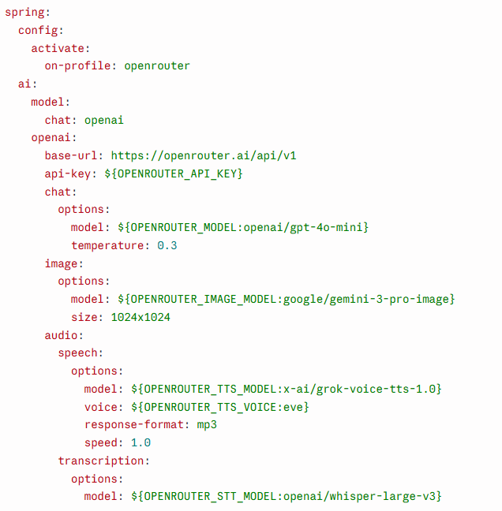
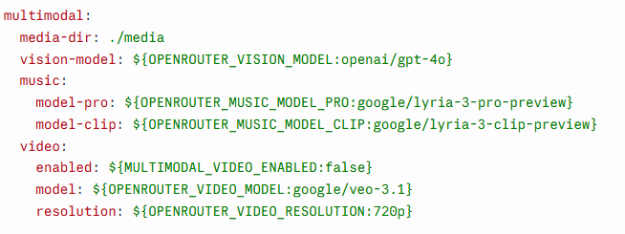
Configuration
Spring AI configuration
Own properties

Slide 37
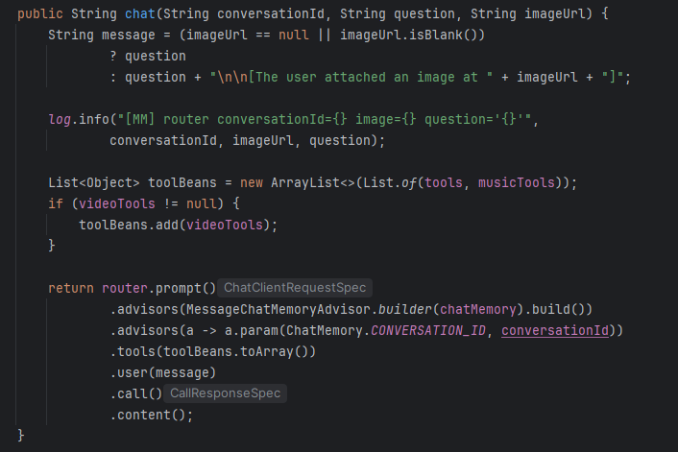
Chat

Slide 38
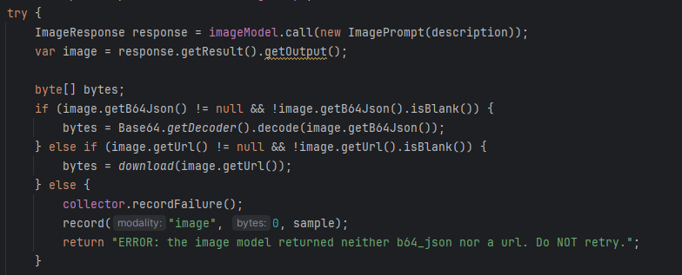
Image Generation

Slide 39
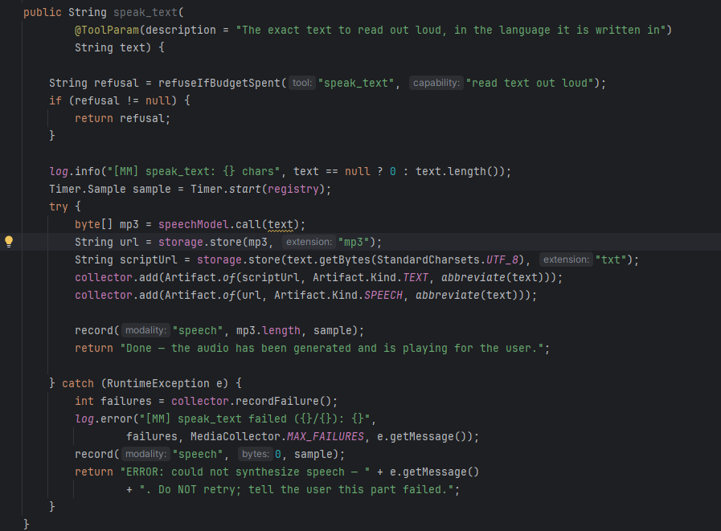
Speech

Slide 40
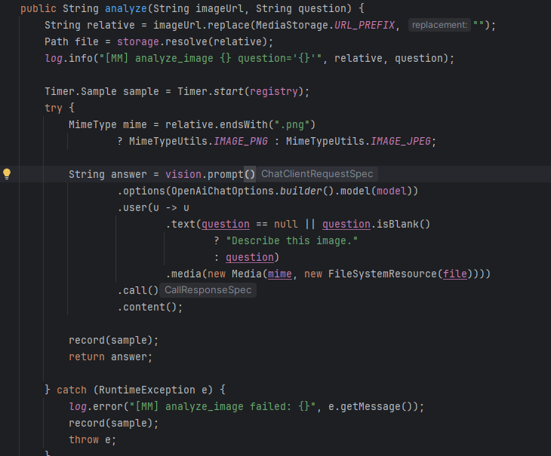
Vision

Slide 41
Music
Here is where the trouble started….
Lyria is a chat endpoint. Getting the bytes out took five attempts.
1. chatModel.call() → timed lyrics, no audio “[0.0:7.3] O-Zone, we dance tonight…]“
2. + getMedia() → media blocks = 0
3. + modalities → `voice` is required, but was not set
4. + voice → 400: Audio output requires stream: true
5. + stream() → the stream arrives, media blocks = 0
Every one of those errors was correct and specific. None of them said where to look.

Slide 42
Why can't Spring AI reach it?
Layer | Behavior
Google | Exposes Lyria through the Interactions API, not /audio/speech
OpenRouter | Returns audio from chat only when stream: true
OpenAI SDK | Validates a speech-oriented request schema and requires voice
Spring AI | Maps audio to Media only in the non-streaming (blocking) path
No layer made a mistake, so no layer could warn.
Music dropped to raw HTTP. One modality on the transport is cheaper than pretending the abstraction covers five.

Slide 43
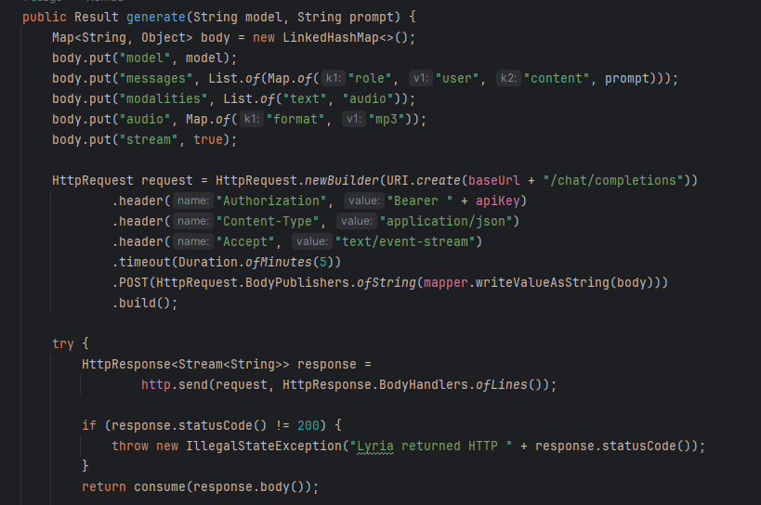
Code Snippet
Bytes

Slide 44
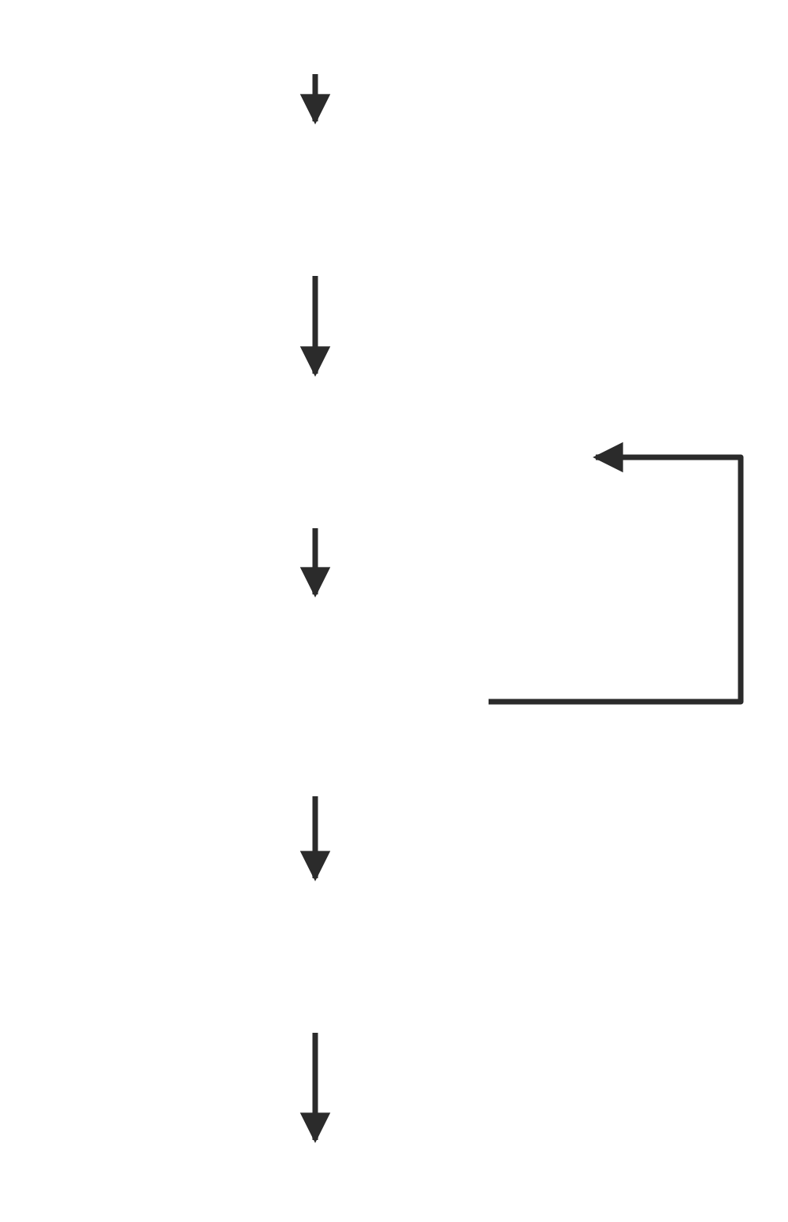
Video
Video generation is asynchronous: submit, poll, download.
There is no VideoModel in Spring AI, so the client is custom.
Music had the opposite problem, the abstraction existed and could not be reached.

Slide 45
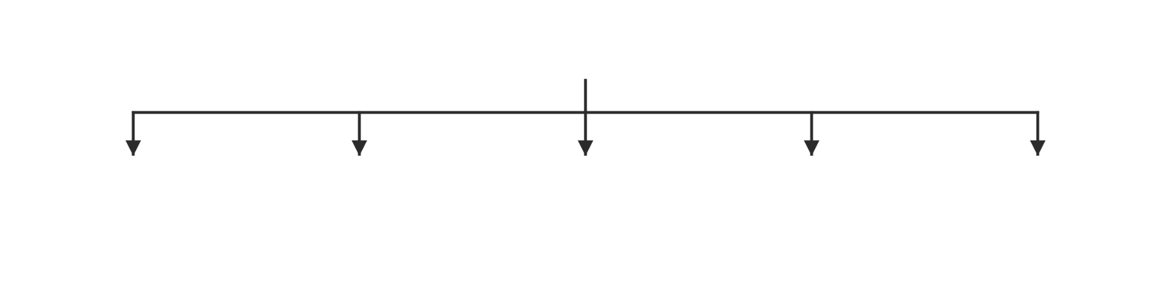
Is one protocol really enough?
One provider does not mean one protocol.

Slide 46

See you in part Ⅱ next week!

